Slide 1
Database Systems
Lecture 1-Chapter # 3
Data Modeling Using the Entity-Relationship (ER) Model
Alina Arshad
alina.arshad@nu.edu.pk

Slide 2
Refining the COMPANY database schema by introducing relationships
By examining the requirements, six relationship types are identified
All are binary relationships( degree 2)
Listed below with their participating entity types:
WORKS_FOR (between EMPLOYEE, DEPARTMENT)
MANAGES (also between EMPLOYEE, DEPARTMENT)
CONTROLS (between DEPARTMENT, PROJECT)
WORKS_ON (between EMPLOYEE, PROJECT)
SUPERVISION (between EMPLOYEE (as subordinate), EMPLOYEE (as supervisor))
DEPENDENTS_OF (between EMPLOYEE, DEPENDENT)

Slide 3
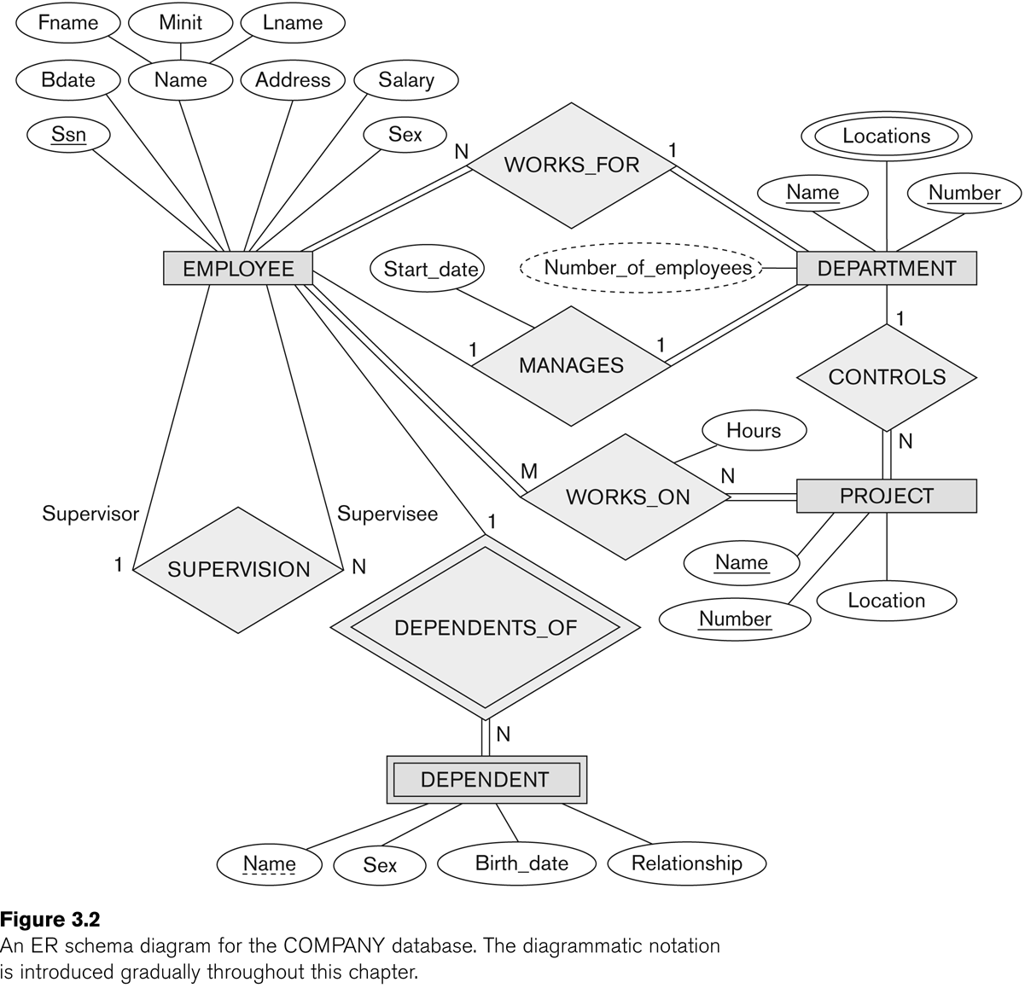
Recursive Relationship Type is: SUPERVISION (participation role names are shown)
Notes:
WORKS_FOR is called total participation, meaning that every entity in the total set of employee entities must be related to a department entity via WORKS_FOR. Total participation is also called existence dependency.
In Figure 3.12 we do not expect every employee to manage a department, so the participation of EMPLOYEE in the MANAGES relationship type is partial, meaning that some or part of the set of employee entities are related to some department entity via MANAGES, but not necessarily all. We will refer to the cardinality ratio and participation constraints, taken together, as the structural constraints of a relationship type

Slide 4
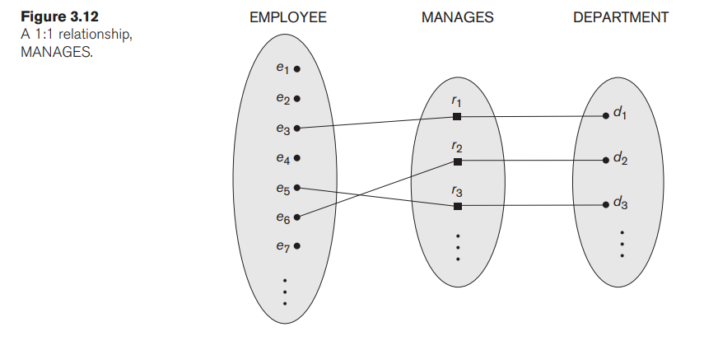
Constraints on Binary Relationship Types
Constraint: each employee must work for exactly one department.
Cardinality Ratios for Binary Relationships.
Maximum number of relationship instances that an entity can participate in.
Cardinality Ratio (specifies maximum participation)
One-to-one (1:1)
One-to-many (1:N) or
Many-to-one (N:1)
Many-to-many (M:N)
Notes:
Constraints on Binary Relationship Types Relationship types usually have certain constraints that limit the possible combinations of entities that may participate in the corresponding relationship set. These constraints are determined from the miniworld situation that the relationships represent. For example, in Figure 3.9, if the company has a rule that each employee must work for exactly one department, then we would like to describe this constraint in the schema. We can distinguish two main types of binary relationship constraints: cardinality ratio and participation.
Cardinality Ratios for Binary Relationships.
The cardinality ratio for a binary relationship specifies the maximum number of relationship instances that an entity can participate in.
For example, in the WORKS_FOR binary relationship type, DEPARTMENT:EMPLOYEE is of cardinality ratio 1:N, meaning that each department can be related to (that is, employs) any number of employees (N),9 but an employee can be related to (work for) at most one department (1). This means that for this particular relationship type WORKS_FOR, a particular department entity can be related to any number of employees (N indicates there is no maximum number). On the other hand, an employee can be related to a maximum of one department. The possible cardinality ratios for binary relationship types are 1:1, 1:N, N:1, and M:N. An example of a 1:1 binary relationship is MANAGES (Figure 3.12), which relates a department entity to the employee who manages that department. This represents the miniworld constraints that—at any point in time—an employee can manage at most one department and a department can have at most one manager. The relationship type WORKS_ON (Figure 3.13) is of cardinality ratio M:N, because the miniworld rule is that an employee can work on several projects and a project can have several employees. Cardinality ratios for binary relationships are represented on ER diagrams by displaying 1, M, and N on the diamonds as shown in Figure 3.2. Notice that in this notation, we can either specify no maximum (N) or a maximum of one (1) on participation. An alternative notation (see Section 3.7.4) allows the designer to specify a specific maximum number on participation, such as 4 or 5

Slide 5
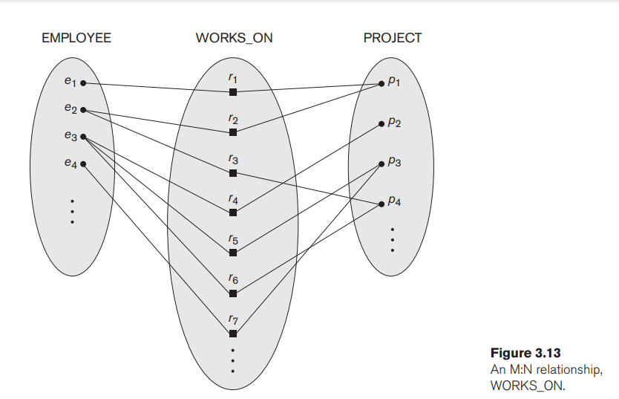

Slide 6
Participation Constraints and Existence Dependencies
Participation constraint: specifies whether the existence of an entity depends on its being related to another entity via the relationship type.
There are two types of participation constraints
Total Participation/ Existence: Employee must work for department otherwise the employee entity does not exist.
Partial Participation: department must have a single manager to manage the department. Manager instances comes from the employee instance set.
Structural Constraints: cardinality ratio and participation constraints.
Notes:
Participation Constraints and Existence Dependencies.
The participation constraint specifies whether the existence of an entity depends on its being related to another entity via the relationship type. This constraint specifies the minimum number of relationship instances that each entity can participate in and is sometimes called the minimum cardinality constraint.
There are two types of participation constraints—total and partial—that we illustrate by example.
If a company policy states that every employee must work for a department, then an employee entity can exist only if it participates in at least one WORKS_FOR relationship instance (Figure 3.9). Thus, the participation of EMPLOYEE in WORKS_FOR is called total participation, meaning that every entity in the total set of employee entities must be related to a department entity via WORKS_FOR. Total participation is also called existence dependency.
In Figure 3.12 we do not expect every employee to manage a department, so the participation of EMPLOYEE in the MANAGES relationship type is partial, meaning that some or part of the set of employee entities are related to some department entity via MANAGES, but not necessarily all. We will refer to the cardinality ratio and participation constraints, taken together, as the structural constraints of a relationship type.
In ER diagrams, total participation (or existence dependency) is displayed as a double line connecting the participating entity type to the relationship, whereas partial participation is represented by a single line (see Figure 3.2). Notice that in this notation, we can either specify no minimum (partial participation) or a minimum of one (total participation). An alternative notation (see Section 3.7.4) allows the designer to specify a specific minimum number on participation in the relationship, such as 4 or 5.

Slide 7
Attributes of Relationship Types
Relationship types can also have attributes.
Notes:
Attributes of Relationship Types
Relationship types can also have attributes, similar to those of entity types. For example, to record the number of hours per week that a particular employee works on a particular project, we can include an attribute Hours for the WORKS_ON relationship type in Figure 3.13. Another example is to include the date on which a manager started managing a department via an attribute Start_date for the MANAGES relationship type in Figure 3.12.

Slide 8
Attributes of Relationship Types
Attributes of 1:1 or 1:N relationship types can be migrated to one of the participating entity types.
For a 1:N relationship type, a relationship attribute can be migrated only to the entity type on the N-side of the relationship.
For M:N (many-to-many) relationship types,
Some attributes may be determined by the combination of participating entities, not by any single entity.
Such attributes must be specified as relationship attributes. An example is the Hours attribute of the M:N relationship WORKS_ON.
Notes:
Notice that attributes of 1:1 or 1:N relationship types can be migrated to one of the participating entity types.
For example, the Start_date attribute for the MANAGES relationship can be an attribute of either EMPLOYEE (manager) or DEPARTMENT, although conceptually it belongs to MANAGES. This is because MANAGES is a 1:1 relationship, so every department or employee entity participates in at most one relationship instance.
Hence, the value of the Start_date attribute can be determined separately, either by the participating department entity or by the participating employee (manager) entity.
For a 1:N relationship type, a relationship attribute can be migrated only to the entity type on the N-side of the relationship.
For example, in Figure 3.9, if the WORKS_FOR relationship also has an attribute Start_date that indicates when an employee started working for a department, this attribute can be included as an attribute of EMPLOYEE. This is because each employee works for at most one department, and hence participates in at most one relationship instance in WORKS_FOR, but a department can have many employees, each with a different start date. In both 1:1 and 1:N relationship types, the decision where to place a relationship attribute—as a relationship type attribute or as an attribute of a participating entity type—is determined subjectively by the schema designer.
For M:N (many-to-many) relationship types, some attributes may be determined by the combination of participating entities in a relationship instance, not by any single entity. Such attributes must be specified as relationship attributes. An example is the Hours attribute of the M:N relationship WORKS_ON (Figure 3.13); the number of hours per week an employee currently works on a project is determined by an employee-project combination and not separately by either entity.

Slide 9
Attributes of Relationship Types
The number of hours per week an employee currently works on a project is determined by an employee-project combination and not separately by either entity.

Slide 10
Weak Entity Types
Weak entity types: Entity types that do not have key attributes of their own and their identification is dependent on another entity type..
Strong entity types: that do have a key attribute.
Always has a total participation constraint (existence dependency) with respect to its identifying relationship:
A weak entity cannot be identified without an owner entity.
Notes:
Weak Entity Types Entity types that do not have key attributes of their own are called weak entity types.
In contrast, regular entity types that do have a key attribute—which include all the examples discussed so far—are called strong entity types.
Entities belonging to a weak entity type are identified by being related to specific entities from another entity type in combination with one of their attribute values. We call this other entity type the identifying or owner entity type, and we call the relationship type that relates a weak entity type to its owner the identifying relationship of the weak entity type.
A weak entity type always has a total participation constraint (existence dependency) with respect to its identifying relationship because a weak entity cannot be identified without an owner entity.
However, not every existence dependency results in a weak entity type. For example, a DRIVER_LICENSE entity cannot exist unless it is related to a PERSON entity, even though it has its own key (License_number) and hence is not a weak entity.
Consider the entity type DEPENDENT, related to EMPLOYEE, which is used to keep track of the dependents of each employee via a 1:N relationship (Figure 3.2). In our example, the attributes of DEPENDENT are Name (the first name of the dependent), Birth_date, Sex, and Relationship (to the employee). Two dependents of two distinct employees may, by chance, have the same values for Name, Birth_date, Sex, and Relationship, but they are still distinct entities. They are identified as distinct entities only after determining the particular employee entity to which each dependent is related.
Each employee entity is said to own the dependent entities that are related to it. A weak entity type normally has a partial key, which is the attribute that can uniquely identify weak entities that are related to the same owner entity.
In our example, if we assume that no two dependents of the same employee ever have the same first name, the attribute Name of DEPENDENT is the partial key.
In the worst case, a composite attribute of all the weak entity’s attributes will be the partial key.
In ER diagrams, both a weak entity type and its identifying relationship are distinguished by surrounding their boxes and diamonds with double lines (see Figure 3.2).
The partial key attribute is underlined with a dashed or dotted line.
Weak entity types can sometimes be represented as complex (composite, multivalued) attributes. In the preceding example, we could specify a multivalued attribute Dependents for EMPLOYEE, which is a multivalued composite attribute with the component attributes Name, Birth_date, Sex, and Relationship.
The choice of which representation to use is made by the database designer. One criterion that may be used is to choose the weak entity type representation if the weak entity type participates independently in relationship types other than its identifying relationship type.
In general, any number of levels of weak entity types can be defined; an owner entity type may itself be a weak entity type.
In addition, a weak entity type may have more than one identifying entity type and an identifying relationship type of degree higher than two, as we illustrate in Section 3.9.

Slide 11
Weak Entity

Slide 12
Weak Entity Types
A weak entity type normally has a partial key, which is the attribute that can uniquely identify weak entities. i.e., Name, Birthdate etc.
Example:
A DEPENDENT entity is identified by the dependent’s first name, and the specific EMPLOYEE with whom the dependent is related
Name of DEPENDENT is the partial key
DEPENDENT is a weak entity type
EMPLOYEE is its identifying entity type via the identifying relationship type DEPENDENT_OF
Notes:
However, not every existence dependency results in a weak entity type. For example, a DRIVER_LICENSE entity cannot exist unless it is related to a PERSON entity, even though it has its own key (License_number) and hence is not a weak entity.
Consider the entity type DEPENDENT, related to EMPLOYEE, which is used to keep track of the dependents of each employee via a 1:N relationship (Figure 3.2). In our example, the attributes of DEPENDENT are Name (the first name of the dependent), Birth_date, Sex, and Relationship (to the employee). Two dependents of two distinct employees may, by chance, have the same values for Name, Birth_date, Sex, and Relationship, but they are still distinct entities. They are identified as distinct entities only after determining the particular employee entity to which each dependent is related.
Each employee entity is said to own the dependent entities that are related to it. A weak entity type normally has a partial key, which is the attribute that can uniquely identify weak entities that are related to the same owner entity.
In our example, if we assume that no two dependents of the same employee ever have the same first name, the attribute Name of DEPENDENT is the partial key.
In the worst case, a composite attribute of all the weak entity’s attributes will be the partial key.
In ER diagrams, both a weak entity type and its identifying relationship are distinguished by surrounding their boxes and diamonds with double lines (see Figure 3.2).
The partial key attribute is underlined with a dashed or dotted line.
Weak entity types can sometimes be represented as complex (composite, multivalued) attributes. In the preceding example, we could specify a multivalued attribute Dependents for EMPLOYEE, which is a multivalued composite attribute with the component attributes Name, Birth_date, Sex, and Relationship.
The choice of which representation to use is made by the database designer. One criterion that may be used is to choose the weak entity type representation if the weak entity type participates independently in relationship types other than its identifying relationship type.
In general, any number of levels of weak entity types can be defined; an owner entity type may itself be a weak entity type.
In addition, a weak entity type may have more than one identifying entity type and an identifying relationship type of degree higher than two, as we illustrate in Section 3.9.

Slide 13
Refining the ER Design for the COMPANY Database
WORKS_FOR, a 1:N (one-to-many) relationship type between DEPARTMENT and EMPLOYEE.
CONTROLS, a 1:N relationship type between DEPARTMENT and PROJECT.
SUPERVISION, a 1:N relationship type between EMPLOYEE (in the supervisor role) and EMPLOYEE (in the supervisee role)
WORKS_ON, determined to be an M:N (many-to-many) relationship type with attribute Hours.
DEPENDENTS_OF, a 1:N relationship type between EMPLOYEE and DEPENDENT
Notes:
Refining the ER Design for the COMPANY Database
We can now refine the database design in Figure 3.8 by changing the attributes that represent relationships into relationship types.
The cardinality ratio and participation constraint of each relationship type are determined from the requirements.
If some cardinality ratio or dependency cannot be determined from the requirements, the users must be questioned further to determine these structural constraints.
■ MANAGES, which is a 1:1(one-to-one) relationship type between EMPLOYEE and DEPARTMENT. EMPLOYEE participation is partial. DEPARTMENT participation is not clear from the requirements. We question the users, who say that a department must have a manager at all times, which implies total participation.13 The attribute Start_date is assigned to this relationship type.
■ WORKS_FOR, a 1:N (one-to-many) relationship type between DEPARTMENT and EMPLOYEE. Both participations are total.
■ CONTROLS, a 1:N relationship type between DEPARTMENT and PROJECT. The participation of PROJECT is total, whereas that of DEPARTMENT is determined to be partial, after consultation with the users indicates that some departments may control no projects.
■ SUPERVISION, a 1:N relationship type between EMPLOYEE (in the supervisor role) and EMPLOYEE (in the supervisee role). Both participations are determined to be partial, after the users indicate that not every employee is a supervisor and not every employee has a supervisor.
■ WORKS_ON, determined to be an M:N (many-to-many) relationship type with attribute Hours, after the users indicate that a project can have several employees working on it. Both participations are determined to be total.
■ DEPENDENTS_OF, a 1:N relationship type between EMPLOYEE and DEPENDENT, which is also the identifying relationship for the weak entity type DEPENDENT.
The participation of EMPLOYEE is partial, whereas that of DEPENDENT is total. After specifying the previous six relationship types, we remove from the entity types in Figure 3.8 all attributes that have been refined into relationships. These include Manager and Manager_start_date from DEPARTMENT; Controlling_department from PROJECT; Department, Supervisor, and Works_on from EMPLOYEE; and Employee from DEPENDENT. It is important to have the least possible redundancy when we design the conceptual schema of a database. If some redundancy is desired at the storage level or at the user view level, it can be introduced later, as discussed in Section 1.6.1.

Slide 14
Alternative (min, max) notation for relationship structural constraints:
Specified on each participation of an entity type E in a relationship type R
Specifies that each entity e in E participates in at least min and at most max relationship instances in R
Default(no constraint): min=0, max=n (signifying no limit)
Must have min≤max, min≥0, max ≥1
Derived from the knowledge of mini-world constraints
Examples:
A department has exactly one manager and an employee can manage at most one department.
Specify (0,1) for participation of EMPLOYEE in MANAGES
Specify (1,1) for participation of DEPARTMENT in MANAGES
An employee can work for exactly one department but a department can have any number of employees.
Specify (1,1) for participation of EMPLOYEE in WORKS_FOR
Specify (1,n) for participation of DEPARTMENT in WORKS_FOR

Slide 15
The numbers mean that for each entity e in E, e must participate in at least min and at most max relationship instances in R at any point in time.
In this method, min = 0 implies partial participation, whereas min > 0 implies total participation.

Slide 16
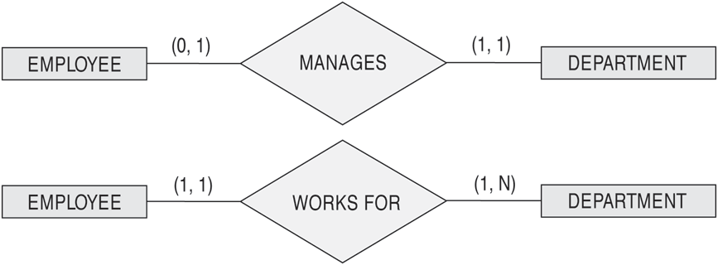
The (min,max) notation for relationship constraints
Read the min,max numbers next to the entity type and looking away from the entity type

Slide 17
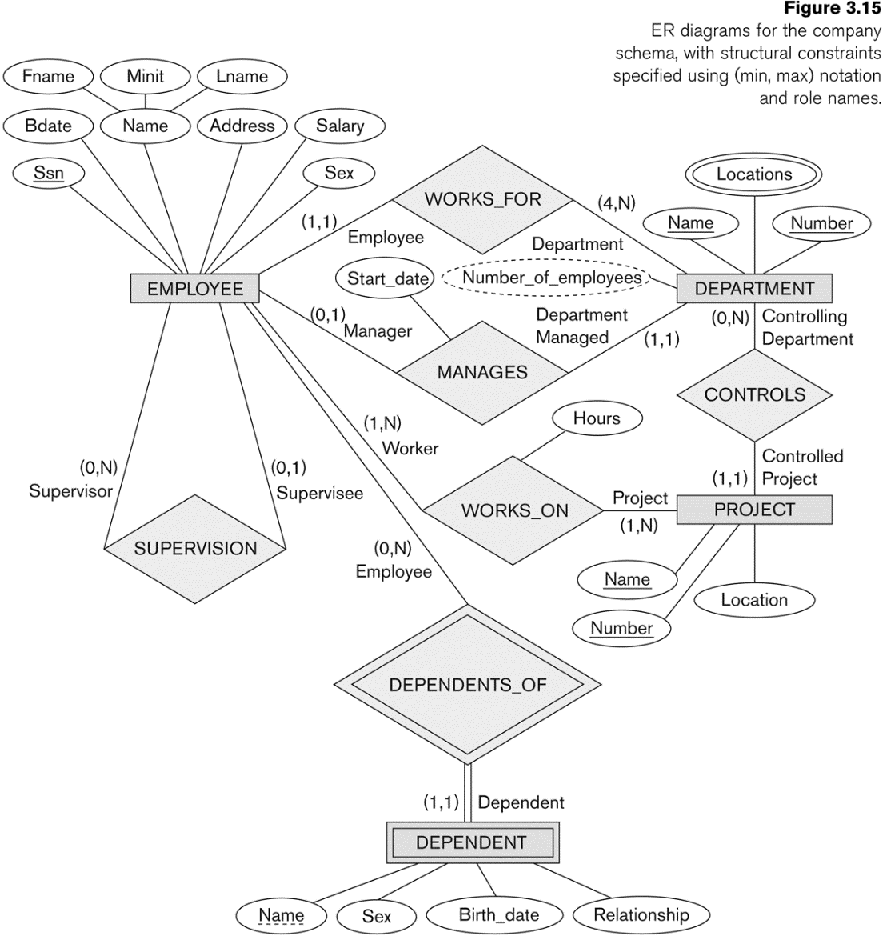
COMPANY ER Schema Diagram using (min, max) notation

Slide 18
Relationships of Higher Degree
Relationship types of degree 2 are called binary
Relationship types of degree 3 are called ternary and of degree n are called n-ary
In general, an n-ary relationship is not equivalent to n binary relationships
Constraints are harder to specify for higher-degree relationships (n > 2) than for binary relationships

Slide 19
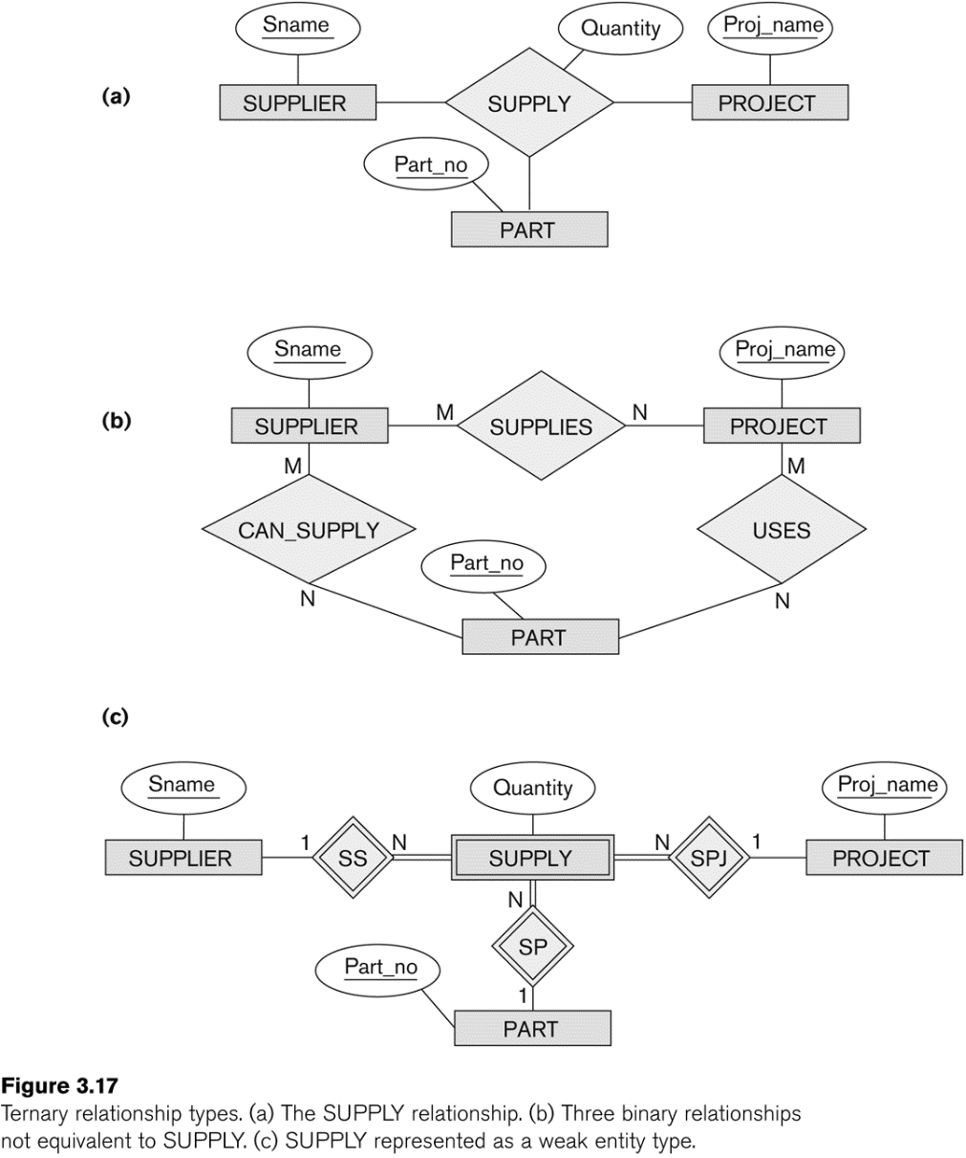
Example of a ternary relationship

Slide 20
Discussion of n-ary relationships (n > 2)
In general, 3 binary relationships can represent different information than a single ternary relationship (see Figure 3.17a and b)
If needed, the binary and n-ary relationships can all be included in the schema design (see Figure 3.17a and b, where all relationships convey different meanings)
In some cases, a ternary relationship can be represented as a weak entity if the data model allows a weak entity type to have multiple identifying relationships (and hence multiple owner entity types) (see Figure 3.17c)

Slide 21
Discussion of n-ary relationships (n > 2)
If a particular binary relationship can be derived from a higher-degree relationship at all times, then it is redundant
For example, the TAUGHT_DURING binary relationship in Figure 3.18 (see next slide) can be derived from the ternary relationship OFFERS (based on the meaning of the relationships)

Slide 22
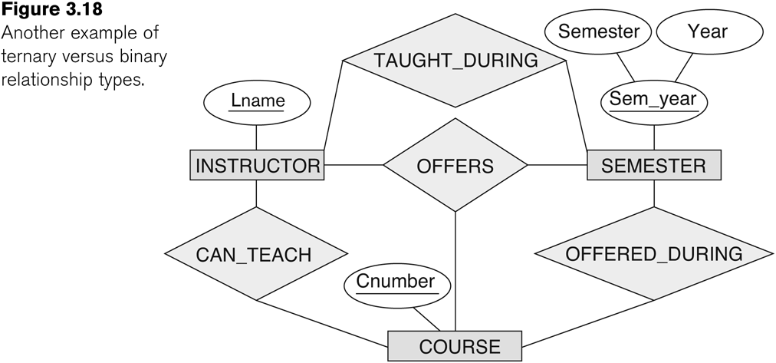
Another example of a ternary relationship

Slide 23
Displaying constraints on higher-degree relationships
The (min, max) constraints can be displayed on the edges – however, they do not fully describe the constraints
Displaying a 1, M, or N indicates additional constraints
An M or N indicates no constraint
A 1 indicates that an entity can participate in at most one relationship instance that has a particular combination of the other participating entities
In general, both (min, max) and 1, M, or N are needed to describe fully the constraints
Overall, the constraint specification is difficult and possibly ambiguous when we consider relationships of a degree higher than two.

Slide 24
Another Example: A UNIVERSITY Database
To keep track of the enrollments in classes and student grades, another database is to be designed.
It keeps track of the COLLEGEs, DEPARTMENTs within each college, the COURSEs offered by departments, and SECTIONs of courses, INSTRUCTORs who teach the sections etc.

Slide 25
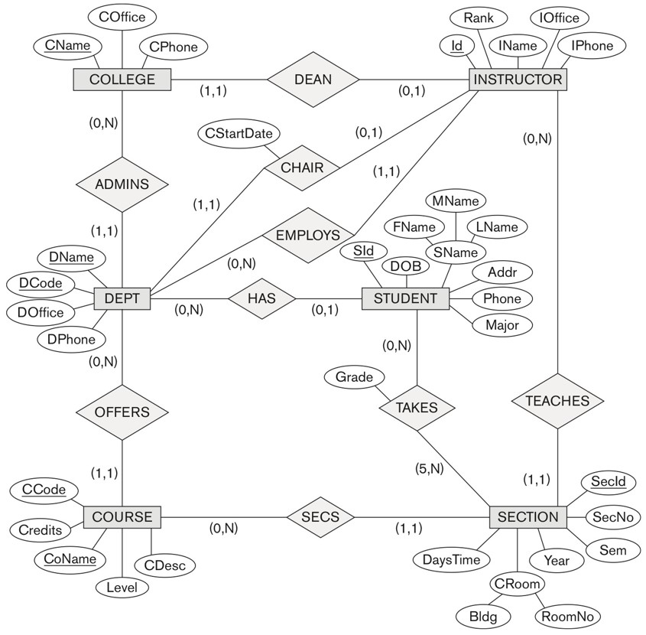

UNIVERSITY database conceptual schema

Slide 26
Some of the Automated Database Design Tools (Note: Not all may be on the market now)
COMPANY | TOOL | FUNCTIONALITY
Embarcadero Technologies | ER Studio | Database Modeling in ER and IDEF1X
 | DB Artisan | Database administration, space and security management
Oracle | Developer 2000/Designer 2000 | Database modeling, application development
Popkin Software | System Architect 2001 | Data modeling, object modeling, process modeling, structured analysis/design
Platinum (Computer Associates) | Enterprise Modeling Suite: Erwin, BPWin, Paradigm Plus | Data, process, and business component modeling
Persistence Inc. | Pwertier | Mapping from O-O to relational model
Rational (IBM) | Rational Rose | UML Modeling & application generation in C++/JAVA
Resolution Ltd. | Xcase | Conceptual modeling up to code maintenance
Sybase | Enterprise Application Suite | Data modeling, business logic modeling
Visio | Visio Enterprise | Data modeling, design/reengineering Visual Basic/C++

